Slide 1

Kwik Trip Results
Isaac Dhyanchand

Slide 2
Data Overview
This analysis investigates how beer caves, and operating costs affect true profit across Kwik Trip store locations.
By examining detailed store-level data, we found that:
Beer caves are correlated with higher profits on average
Depreciated asset costs were factored into a “true profit” metric to give a more complete financial picture
Disparity in sales of in-cave and out-of-cave products

Slide 3
True Profit Calculation
True Profit accounts for key expenses including electricity, repair & maintenance (R&M) costs, and asset depreciation. The formula is:
Electricity Costs: Based on energy usage (e.g., $3,440.32/year for 33,080 kWh).
R&M Costs: Total repair and maintenance expenses.
Depreciation: Cave asset value depreciated over 7 years. New caves, and caves 8+ years old excluded.
This formula provides an accurate reflection of the store's financial performance.
True Profit = Gross Profit – Electricity Costs – Total R&M Costs – Depreciation

Slide 4
Most Profitable Stores
Key Insight: The most profitable stores all feature beer caves.
Trend: Beer caves contribute significantly to higher profitability, likely through increased alcohol sales.
Electricity Costs: Stores with beer caves are charged for the electricity used by the cave, averaging $3,440.32 annually. Stores without caves are not charged.
Additional Factors: Low expenses in repairs and maintenance are also common among these top stores.
Store 413 Profit: $114,068 Cave? Yes
Store 761 Profit: $107,988 Cave? Yes
Store 391 Profit: $99,861 Cave? Yes
Store 750 Profit: $97,843 Cave? Yes
Store 827 Profit: $96,941 Cave? Yes

Slide 5
Most Profitable Stores (no cave)
Top-performing stores without beer caves still show solid profits, led by Store 788 at $90K. However, all top 5 most profitable stores have beer caves, suggesting that caves may contribute significantly to higher store profitability.
Store 788 Profit: $90,697.94
Store 444 Profit: $82,371.25
Store 399 Profit: $76,201.22
Store 763 Profit: $72,414.05
Store 159 Profit: $72,286.14

Slide 6
Least Profitable Stores:
Stores with low true profit tend to have high net asset value, since they are newer stores (start up cost). Note all these stores also have caves.
Store 1725 Profit: -$6,429.02
Store 1293 Profit: -$6,119.67
Store 1295 Profit: -$5,696.28
Store 1286 Profit: -$4,961.76
Store 611 Profit: -$3,275.35

Slide 7
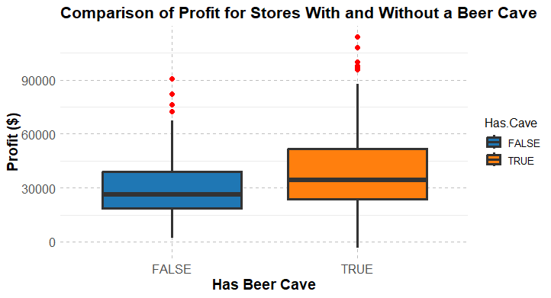
Stores with vs. without Beer cave
Stores with beer caves generally show higher true profit, but also greater variability.
The median true profit is noticeably higher for stores with caves, suggesting that installing a beer cave tends to be a profitable investment, even though some stores experience more risk.

Slide 8
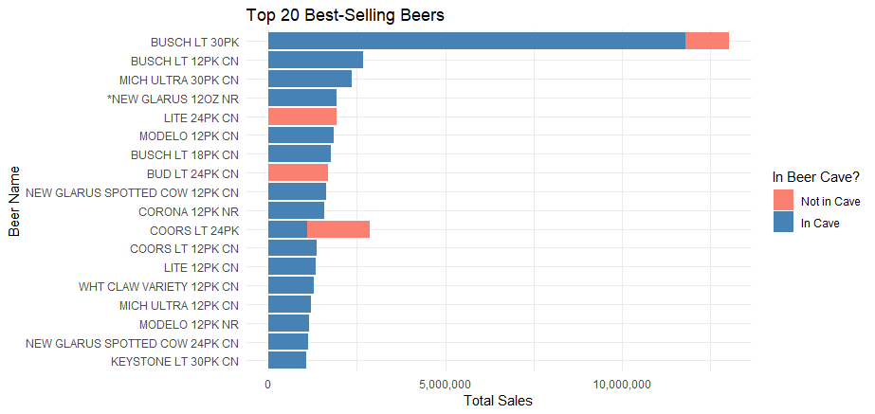
Best Selling Products
Top Sellers: Highlighting the most popular products, including beer and related items.
Sales Breakdown:
Beer Cave Sales: A significant portion of sales come from beer cave transactions.
Non-Cave Sales: Remaining sales stem from regular store areas, excluding the beer cave.
Insights: The presence of the beer cave drives a larger share of beer-related sales, contributing to higher overall profits.

Slide 9
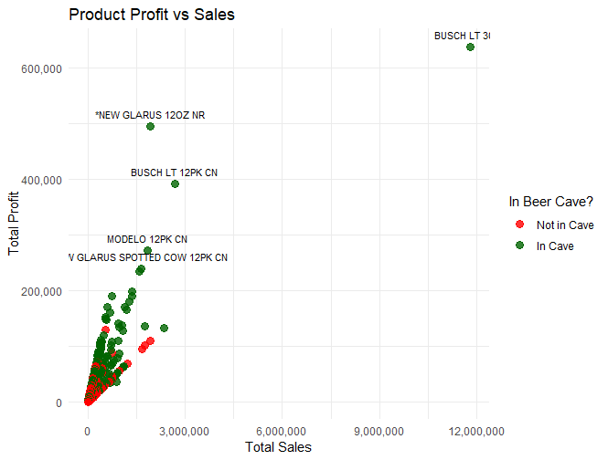
Most Profitable Products
Products stored in the beer cave (green) generally show higher total sales than those not stored in the cave (red). This suggests that beer cave placement may positively influence consumer purchasing behavior.

